Slide 1
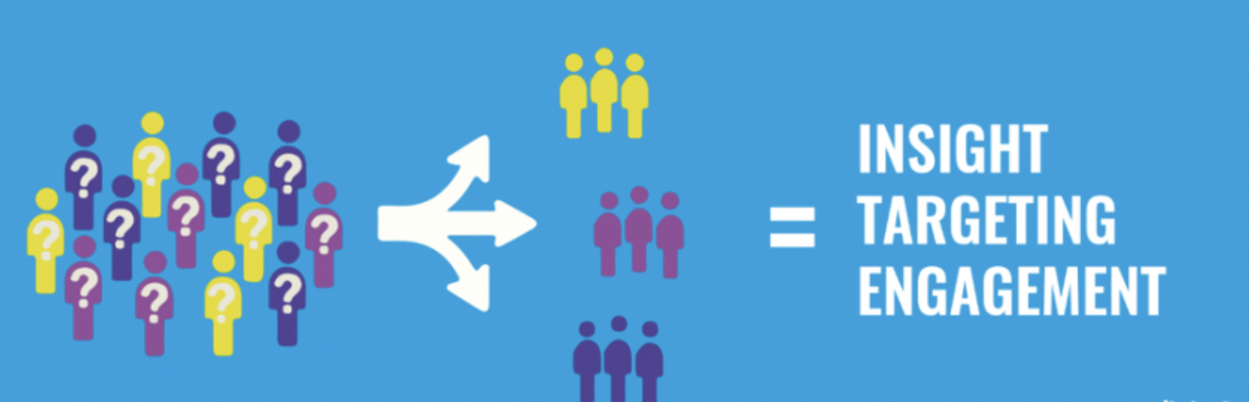

Customer Segmentation & Recommendation System
Thanks to Springboard Mentor
Tony Peak

Slide 2
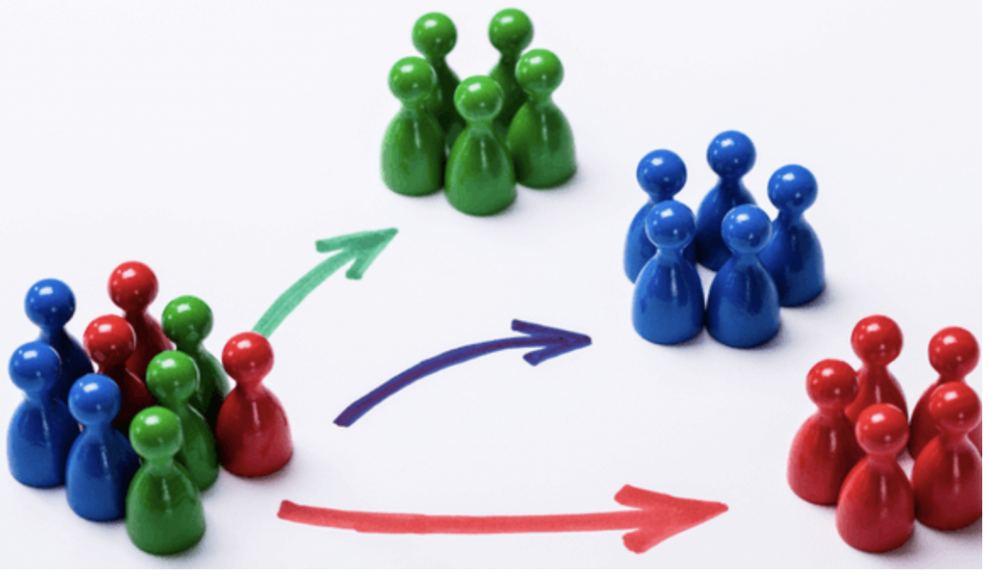
Problem Statement
Customer Segmentation is the strategy that is used to find discrete customer groups that share similar characteristics. The idea behind customer segmentation is to split the user-base into smaller groups that can be targeted with specialized content and offers.
How can the data be preprocessed in order to correctly segment users into groups of similar people?
What is a reasonable cluster size?
What insights can we get from these cluster segments?
How can the created clusters be used in the application to target users with specialized content e.g. item recommendations?

Slide 3
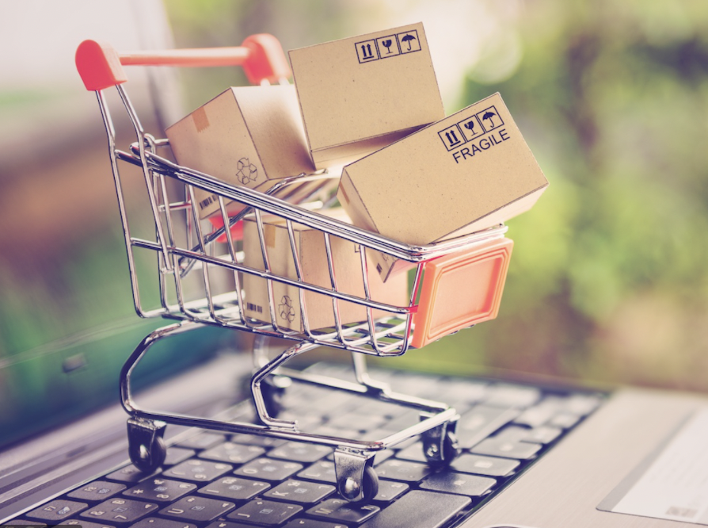
Data Used
The data used is a public dataset from the UCI Machine Learning Repository on transactions occurring between 01/12/2010 and 09/12/2011 for a UK-based and registered non-store online retail.
The company mainly sells unique all-occasion gifts. Many customers of the company are wholesalers.
The dataset contains one million unique transactions and has 8 attributes.

Slide 4
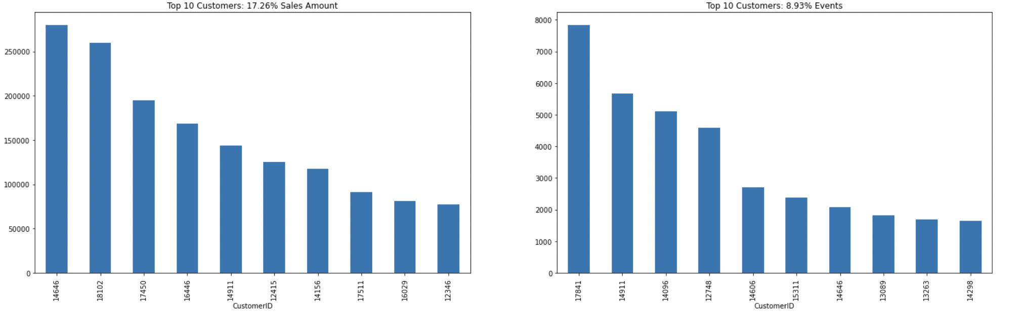
Data Trends
Contribution of top 10 customers to revenue and total orders
Top 10 customers contribute approximately to 18% of revenue and 9.0% of orders .

Slide 5
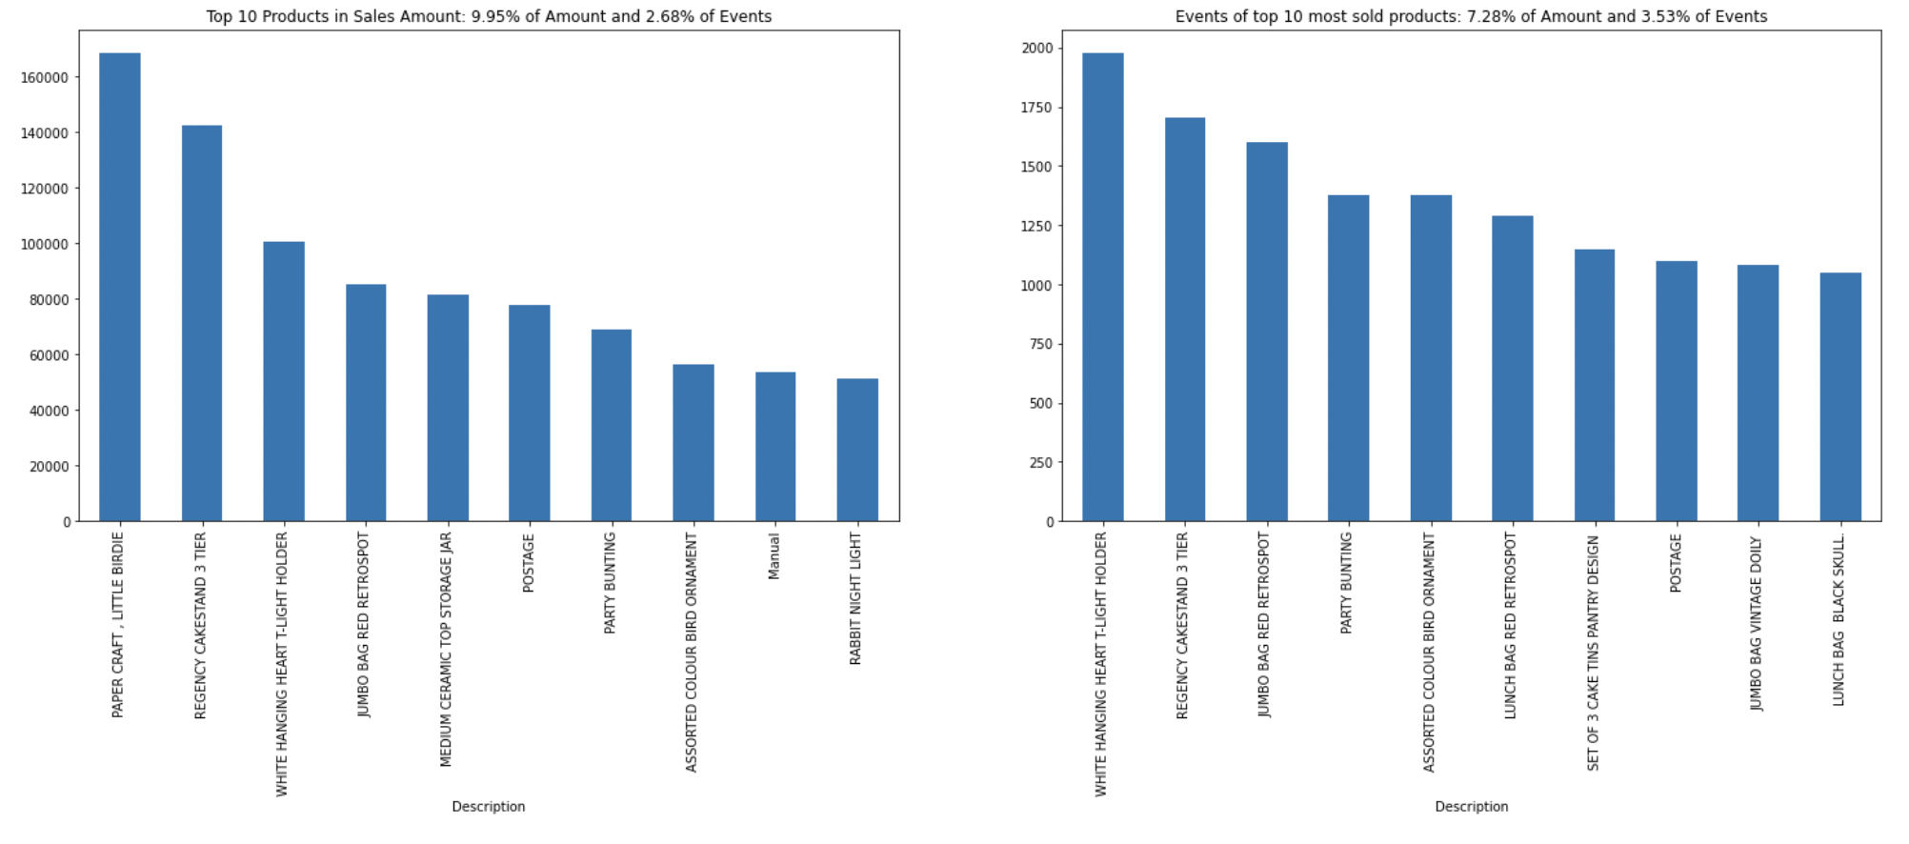
Data Trends
Top 10 products and what is their contribution to revenue and total orders
Top 10 product by revenue contributes to 9.95% total revenue and 2.68% of the orders.
Top 10 most sold products contribute to 7.28% of revenue and 3.53% of orders.

Slide 6
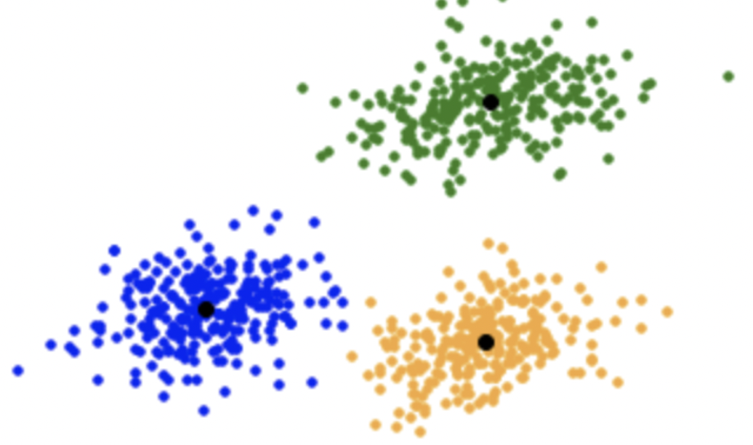
Data Modeling
In the context of customer segmentation, cluster analysis is the use of a mathematical model to discover groups of similar customers based on finding the smallest variations among customers within each group.
k-means cluster analysis is a common cluster analysis method used in customer segmentation.
Since the dataset is limited to the sales records, and does not include any other information about our customers, I used a RFM,*Recency, Frequency and Monetary Value, based model of customer value for finding customer segments.
The following techniques were used to identify the optimal number of clusters.
Elbow method
Gap Statistic
Silhouette Coefficient
The best value for number of clusters from these methods was 3.

Slide 7
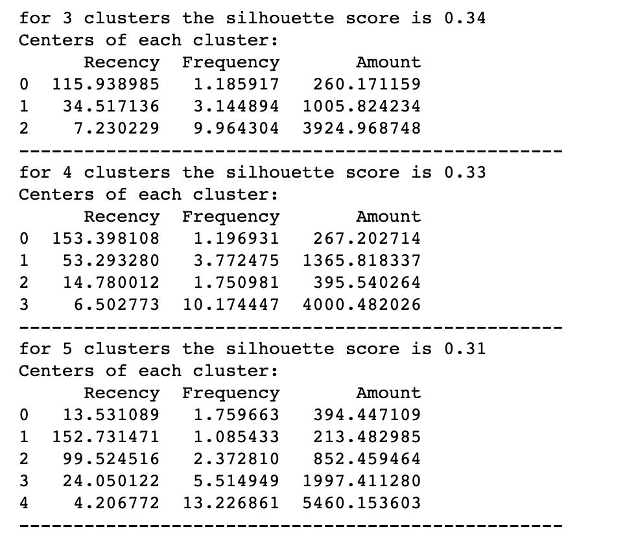
Cluster Insights
Analysis: Three-cluster
The three clusters appear to have a good difference in the Monetary value of the customer.
Cluster 2 is the cluster of high value customers who shop frequently and is the important segment for any business.
In the similar way we obtain customer groups with low and medium spends in clusters with labels 2 and 0 respectively.
Frequency and Recency correlate perfectly to the Monetary value based on the trend (High Monetary-Low Recency-High Frequency).

Slide 8
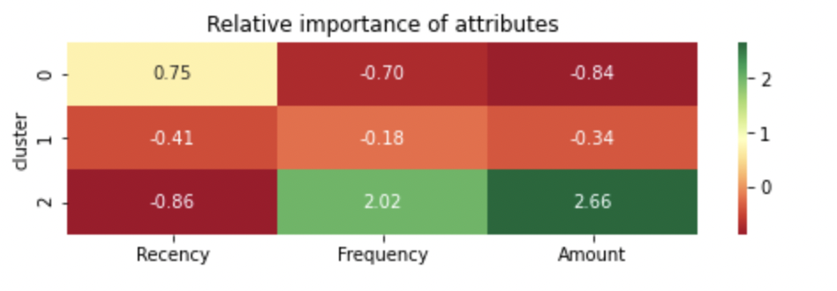
Relative importance of attributes
One can quickly notice that the Top group corresponds to cluster 2 in the heatmap and to what extent the exact numeric values differ in the two groups.

Slide 9
Conclusions
Discovery and the quality of clustering can be improved by adding other customer information and purchase details in this dataset.
For example:
New indicators, such as customer relationship time, based on the date of first purchase of the client.
Some group or category of product to be obtained through the SKUs.
Another dimension to explore can be trying out different algorithms for performing the segmentation for instance hierarchical clustering.

Slide 10
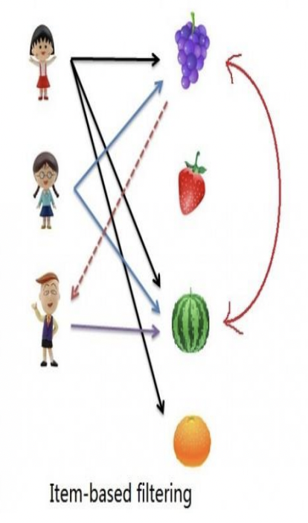
Recommendation System
Problem Statement
Find out how we can use the collaborative filtering, i.e. the user is recommended items that people with similar tastes and preferences liked in the past. In other words, how we can predict unknown ratings by using the similarities between users.

Slide 11
Data set used
The same UCI Machine Learning Repository on online retail transactions was used to develop recommendation system algorithms, with the Surprise library.
Surprise package has been specially developed to make recommendation based on collaborative filtering easy and has default implementation for a variety of CF algorithms.
Surprise requires the data frame to have three columns, corresponding to the user ids, the item ids, and the ratings in this order. Each row thus corresponds to a given rating.
The transaction dataset did not have any ratings and had to be built based on the number of times an item was ordered by a user.

Slide 12
Model Benchmarking
The following algorithms were benchmarked:
KNNWithZScore - KNNWithZScore is a basic collaborative filtering algorithm, taking into account the z-score normalization of each user.
KNNWithMeans - KNNWithMeans is a basic collaborative filtering algorithm, taking into account the mean ratings of each user.
KNNBaseline - KNNBaseline is a basic collaborative filtering algorithm taking into account a baseline rating.
KNNBasic - KNNBasic is a basic collaborative filtering algorithm.

Slide 13
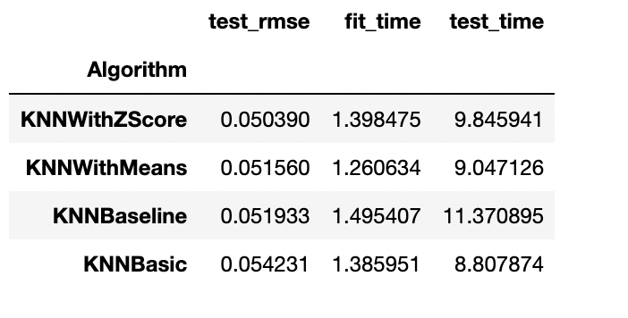
Scoring and Metrics
RMSE was used as accuracy metric for the predictions.
KNNWithZScore algorithm gave the best RMSE.

Slide 14
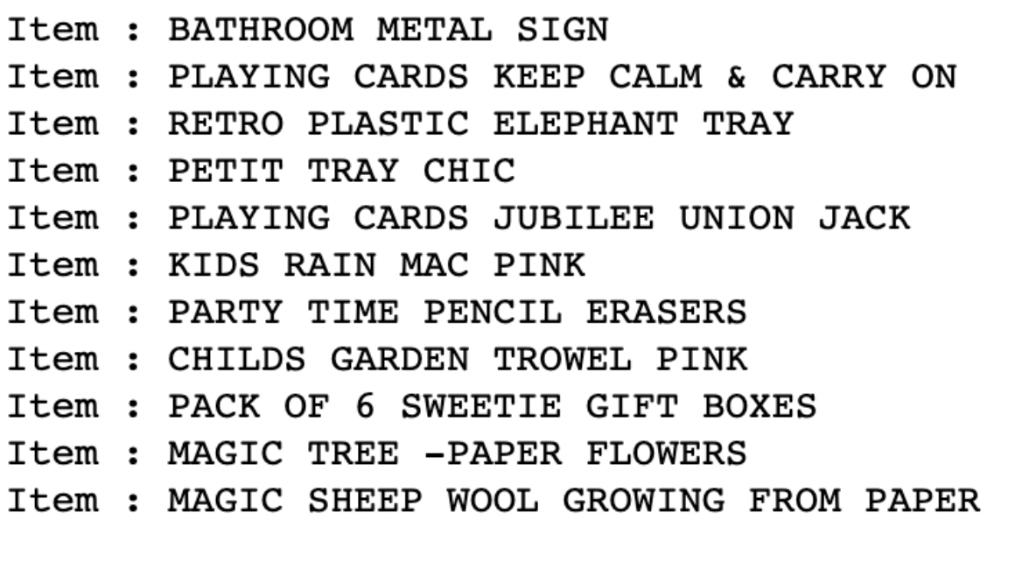
Tuning Parameters & Recommendation
Surprise provides a GridSearchCV, With a dict of all parameters, used this GridSearchCV to find the best parameters for any accuracy measure.
Checked which similarity metric works best with the chosen model and built a full Surprise training set from the dataset.
Finally checked how the final recommendations looks for a specific customer and got the top recommended items for the user.

Slide 15
Conclusion
Surprise makes it easy to implement neighborhood and Similarity based recommendation algorithms. There are more sophisticated algorithms based on deep learning that can be used.
Apart from KNN based there are also other types of algorithms like matrix factorization based algorithms that are supported by surprise package for collaborative filtering.

Slide 16
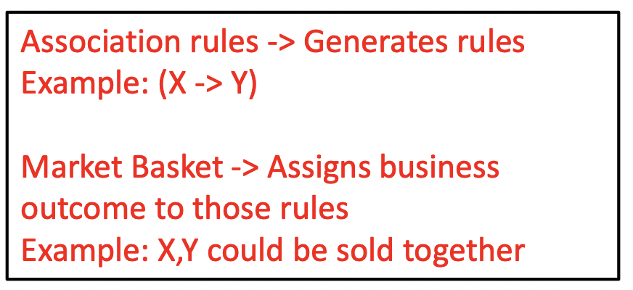
Market Basket Analysis
Market basket analysis is a set of calculations meant to help businesses understand the underlying patterns in their sales.
The sales of certain goods are complementary, they are often bought together and Apriori Algorithm can uncover them.
It is a technique or algorithm to identify the association rules from your data
• Input • List of purchases by customers over different visits
Output • What items purchased together?

Slide 17
Apriori Algorithm
It works basically on following concepts
Support: What is co-occurrence of two items name A and B
Confidence: The proportion of transactions which contain A and also contain B
Lift:Ratio of (B in presence of A) and (B in absence of A)
• Larger the lift ratio, the more significant the association.
Used Apriori an association Rule-based algorithm and generated
Frequent Itemset Generation: All frequent itemsets with support >= predetermined min_support count.
Rule Generation: Listed all Association Rules from frequent itemsets. Calculated support and Confidence for all rules. Pruned the rules that fail min_support and min_confidence thresholds.

Slide 18
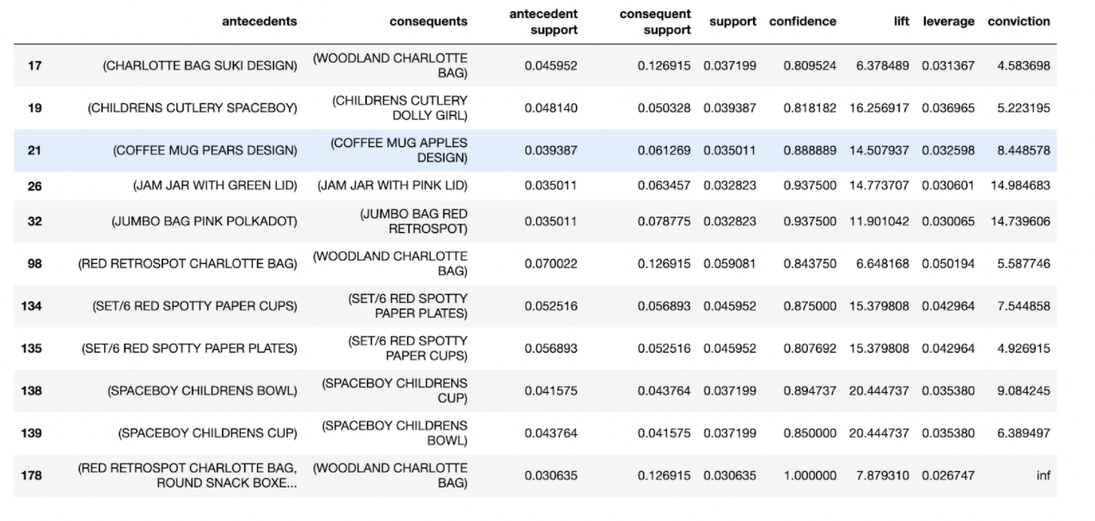
Recommendations
The generated rules are as shown:
Based on these rules we can see how much opportunity there is to use the popularity of one product to drive sales of another.

Slide 19
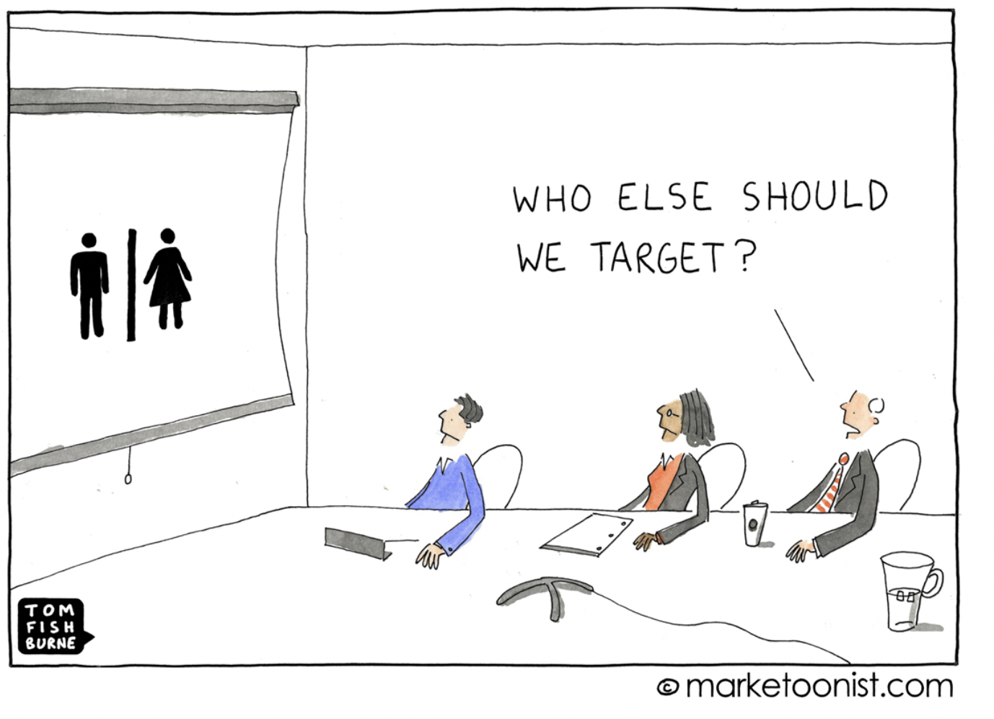
Thank you

